Slide 1


ASK MATE
II
A CodeCool project

Slide 2



AGENDA
8. Future plans
7. Challenges
6. Demo
9. Q&A session
5. Features
4. Task distribution
3. Sprint timeline
2. Used technologies
1. Project team

Slide 3




PROJECT TEAM
Marcin Szkurłat
Marcin
Stodolny
Tomek
Citko

Slide 4












USED TECHNOLOGIES

Slide 5

MONDAY
TUESDAY
WEDNESDAY
THURSDAY
FRIDAY
SPRINT TIMELINE
Merging previous sprint
Adjusting everything to SQL database
Adding comments to questions
Searching questions
Editing answers
Editing comments
Deleting comments
Searching questions
Displaying latest questions
Adding tags
Fancy search results
Deleting tags
Styling website (CSS)
Cleaning code
Code cleaning
Final presentation

Slide 6
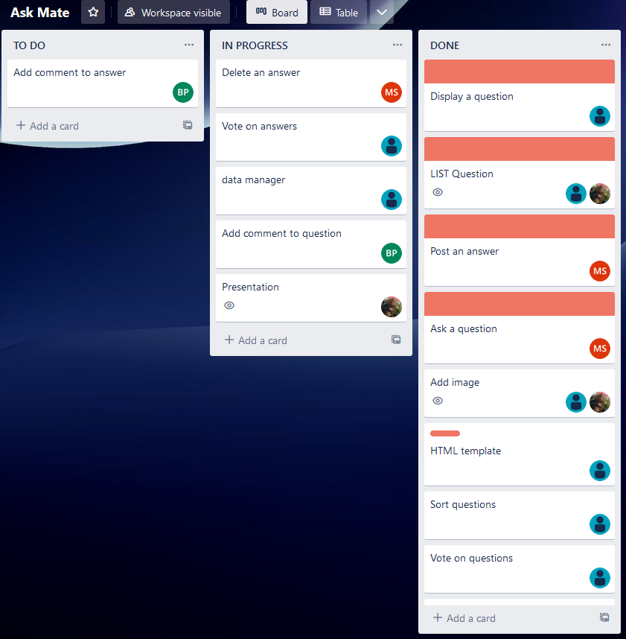

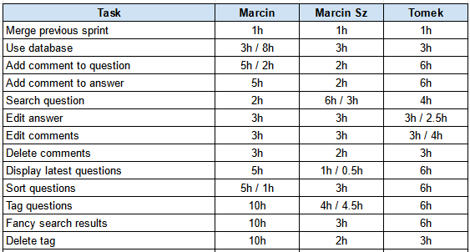
TASK DISTRIBUTION

Slide 7
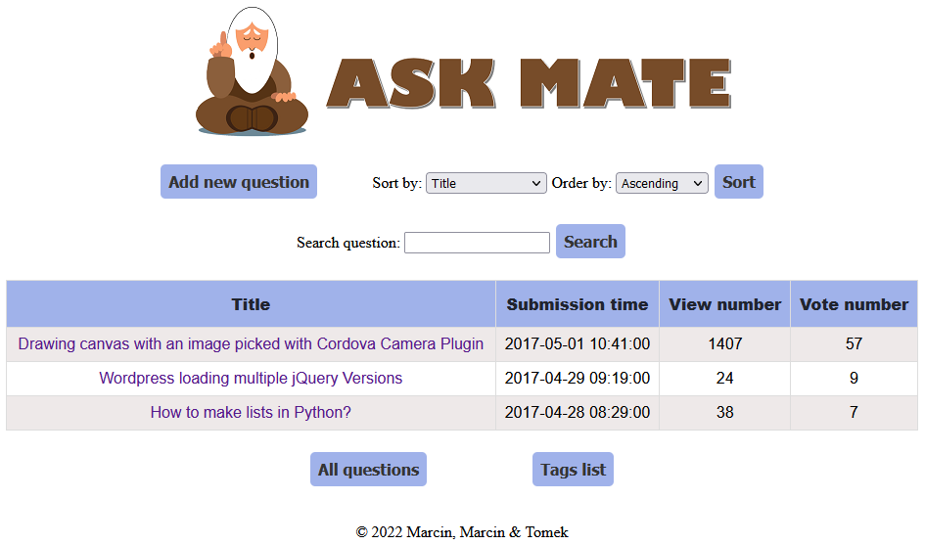

Web app features
Anyone can add questions.
Anyone can answer.
Each question and each answer can be upvoted or downvoted.
Each contribution expands database of wisdom.
Each vote helps others to find the best answer.
Adding images.
WWW.ASKMATE.CC

Slide 8
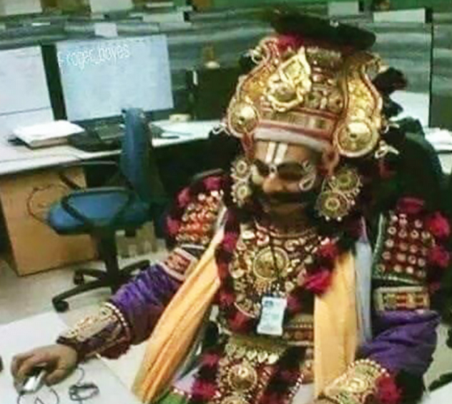
NEW FEATURES (Sprint II)
SQL database implemented (impoved scalability and flexibility)
Search function
Added comments
Added tags
More editing and deleting options
Only SQL
my fren

Slide 9
DEMO
ENJOY!

Slide 10

@app.route("/")
@app.route("/list")
def hello():
all_questions = data_manager.get_all_data_from_file("questions.csv")[::-1]
for item in all_questions:
date = datetime.date.fromtimestamp(int(item[2]))
item[2] = f"{date.day}-{date.month}-{date.year}"
return render_template('index.html', all_questions=all_questions, QUESTION_HEADER=QUESTION_HEADER)
@app.route("/question/<question_id>")
def display_question(question_id):
questions = data_manager.get_all_data_from_file("questions.csv")
current_question = questions[int(question_id)-1]
questions[int(question_id)-1][HEADERS_INDEX["view number"]] = int(questions[int(question_id)-1][HEADERS_INDEX["view number"]]) + 1
data_manager.write_file("questions.csv", questions)
duration = int(time.time() - int(current_question[HEADERS_INDEX["submission time"]]))
return render_template('question.html', question=current_question[1:], time=str(datetime.timedelta(seconds=duration)), question_id=question_id)
@app.route("/add_question", methods=['GET', 'POST'])
def add_question():
all_questions = data_manager.get_all_data_from_file("questions.csv")
new_question = ["" for _ in range(7)]
if request.method == 'POST':
new_question[HEADERS_INDEX["id"]] = len(all_questions) + 1
new_question[HEADERS_INDEX["title"]] = request.form['title']
new_question[HEADERS_INDEX["submission time"]] = int(time.time())
new_question[HEADERS_INDEX["view number"]] = 0
new_question[HEADERS_INDEX["vote number"]] = 0
new_question[HEADERS_INDEX["message"]] = request.form['message']
data_manager.write_file("questions.csv", all_questions, new_question)
if request.files:
img = request.files["file"]
way = (os.path.abspath("static\\upload\\"))
img.save(f"{way}\\test.jpg")
return redirect(f"/question/{new_question[0]}")
return render_template('add_question.html',
title="Add question")
@app.route("/question/<question_id>/edit", methods=['GET', 'POST'])
def edit_question(question_id):
id_index = int(question_id) - 1
all_questions = data_manager.get_all_data_from_file("questions.csv")
edited_question = list(all_questions[id_index])
if request.method == 'POST':
edited_question[HEADERS_INDEX['title']] = request.form['title']
edited_question[HEADERS_INDEX['message']] = request.form['message']
all_questions.pop(id_index)
all_questions.insert(id_index, edited_question)
data_manager.write_file("questions.csv", all_questions)
return redirect(f"/question/{question_id}")
return render_template('edit_question.html',
title="Edit question",
question_id=question_id,
question_title=edited_question[HEADERS_INDEX['title']],
question_message=edited_question[HEADERS_INDEX['message']])
@app.route("/question/<question_id>/delete", methods=['GET', 'POST'])
def delete_question(question_id):
id_index = int(question_id) - 1
all_questions = data_manager.get_all_data_from_file("questions.csv")
if request.method == 'POST':
all_questions.pop(id_index)
data_manager.write_file("questions.csv", all_questions)
return redirect('/')
@app.route("/votes", methods=["POST"])
def up_vote():
all_questions = data_manager.get_all_data_from_file("questions.csv")
index = None
if request.method == "POST":
if request.form.get("vote_up"):
index = int(request.form.get("vote_up")) - 1
all_questions[index][HEADERS_INDEX["vote number"]] = int(all_questions[index][HEADERS_INDEX["vote number"]]) + 1
elif request.form.get("vote_down"):
index = int(request.form.get("vote_down")) - 1
all_questions[index][HEADERS_INDEX["vote number"]] = int(all_questions[index][HEADERS_INDEX["vote number"]]) - 1
data_manager.write_file("questions.csv", all_questions)
return redirect(f"/question/{index + 1}")
CHALLENGES
Rebuilding web app for Postgresql
Flask to database issues

Slide 11
Future plans
Implement user accounts with login, registration and reputation.
Integrate web app with other platforms (facebook, twitter etc.)
Add options to organize webinars related to most searched questions.
JavaScript
help plz

Slide 12

ANY
QUESTIONS?

